Slide 1
Japan Self-Guided Tour Planning
MSIT56 No.4 王柏樺 (Boris Wang)
2023/12/26

Slide 2
Table of contents
01
02
Motivation
Function
03
04
Demo
Further more
Why choose this topic
Web using language
Website Demo
Next step to improve

Slide 3
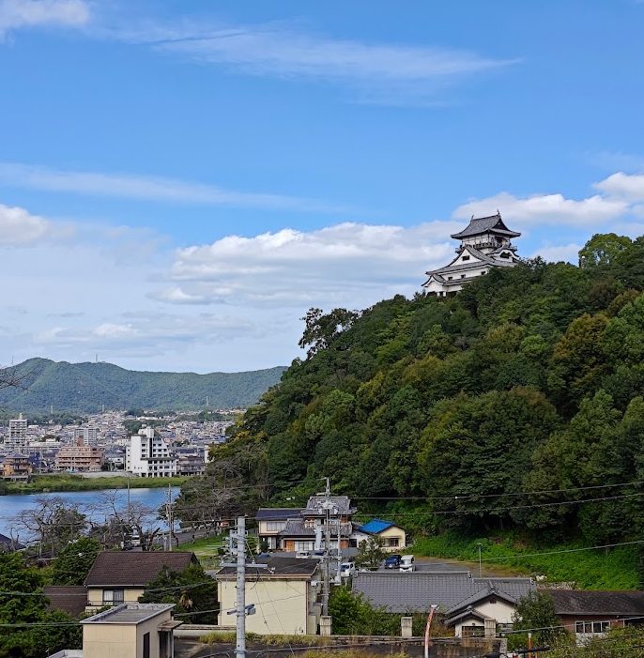
Motivation
➜Used to plan self-guided travel to Japan, would like to share planning experience!
Self planning Travel Experience to Japan
1 | 2019/03/13-03/18 | 東京十社巡り
2 | 2019/08/28-09/06 | 京-阪-神-奈
COVID-19 2019/E-2022/E
3 | 2023/03/25-04/07 | 關東-關西之旅
4 | 2023/10/02-10/12 | 長野-名古屋-岡山-廣島の旅

Slide 4
Web using function
HTML5+CSS
<Map> with cord setting-HTML5
@media for Homepage-CSS
Javascript
Simulation table for planning and cost analysis
Area information Card display
Chart.js
Jquery import
Map with Highlight zone
ImgRwd
3. Snow special efficacy

Slide 5
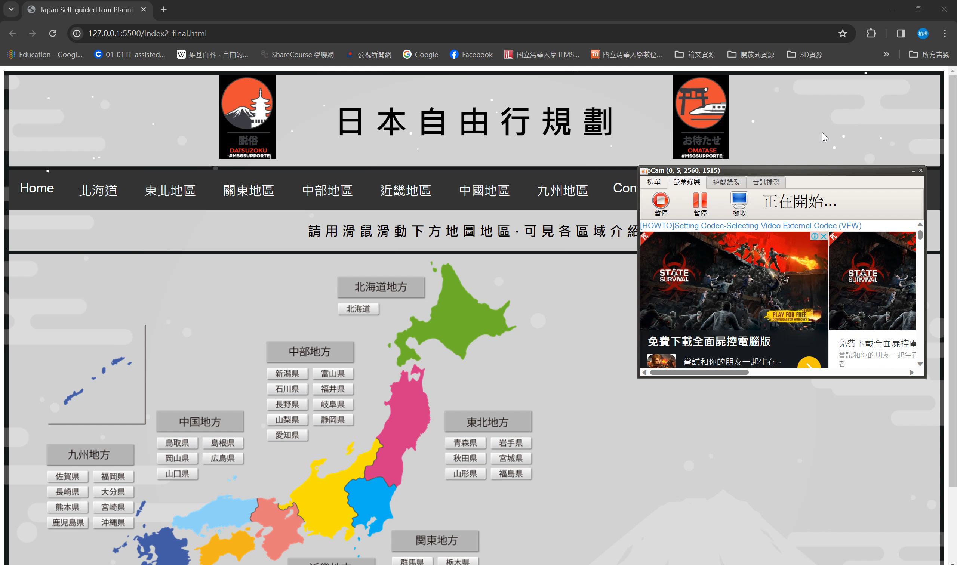
Web Demo

Slide 6
Further more
Complete all area information(potential with commercial cooperation)
Update Img to database to maintain easily
RWD for all page

Slide 7

Thank you for your time

